Slide 1
SPRING SEMESTER
Teacher Notes
This activity is meant to function as a bell-ringer for my Drama 1 students as they come in. I will put the slide up on the board as they come in, maybe play some music from the show as they are entering, and then get settled and take attendance. I will require my students to copy all the information on the slide in an organized fashion. After about 5-7 minutes, I will lead a small lesson about the show, giving them the information contained in the second slide (pictures and video). My expectations for this activity is that it builds their musical knowledge and gives them a broader understanding of this large genre of Theatre.
Feel free to make a copy of this (File → Make a copy) if you want to change anything for your own purposes. Otherwise, you can simply add this to your drive (click the little icon by the document title).
Please do not try to sell this. It was created to be shared as a FREE resource. I surveyed just under 170 theatre educators to create this list. Works cited are at the end. If you have questions, feel free to email me: dmyers@osd.wednet.edu Happy Monday!

Slide 2
TITLE OF MUSICAL
Here is where a brief summary of the plot of the musical goes. Just enough to give away the story without spoiling the whole thing. No more than three sentences.
Book by: John Smith
Lyrics by: John Smith
Music by: John Smith
Choreography by: John Smith
Opened on Broadway: Sept 9, 2020
Awards, etc.: None
Today’s Date: September 9, 2020
Notes:
DEMO SLIDE
If you need more copy this.

Slide 3
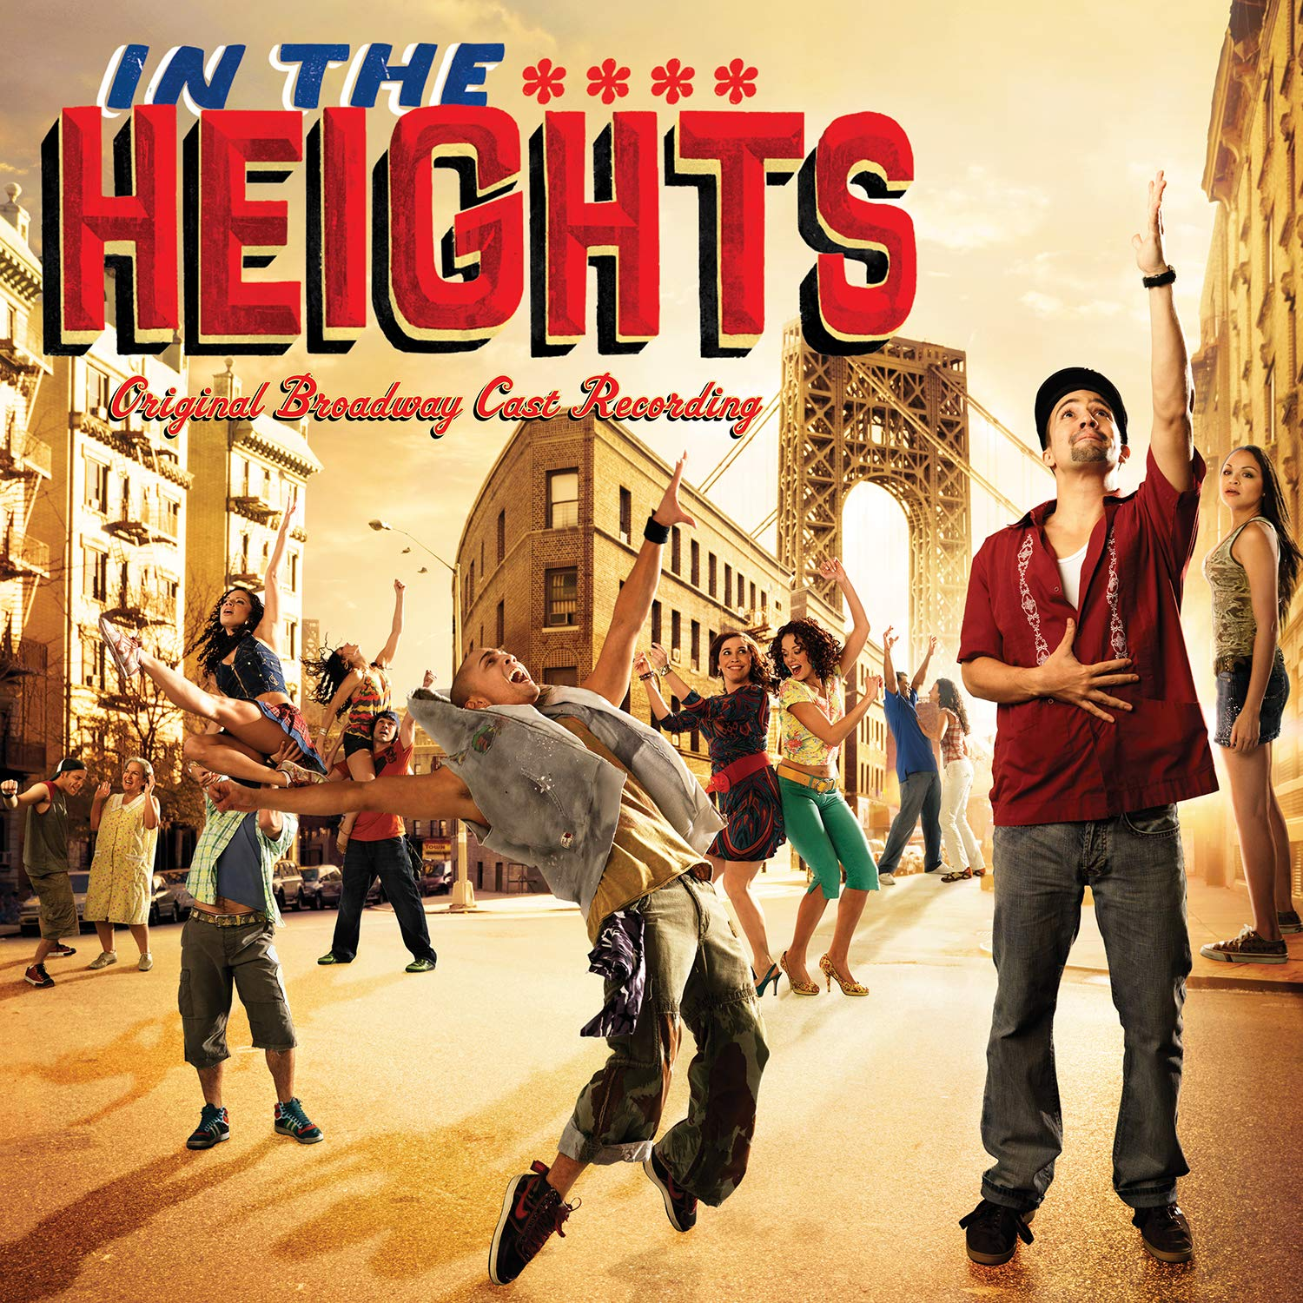
In The Heights
Nina has just returned to her Washington Heights neighborhood from her freshman year at Stanford, unsure if she plans to go back; her parents struggle to keep their small business alive and Benny, their young employee, does his best to help the company stay afloat; Usnavi operates a tiny bodega, and his love interest, Vanessa, only dreams of
finding a studio apartment
in the coveted West Village.
When the winning lottery
ticket, a power outage, and
romantic tension all hit the
‘hood, the long-time
friends and neighbors
make discoveries about
each other, about
themselves, and about the
place they all call home.
Music and Lyrics by: Lin-Manuel Miranda
Book by: Quiara Alegría Hudes
Directed by: Thomas Kail
Choreography by: Andy Blankenbuehler
Music Direction and Orchestrations: Alex Lacamoire
Produced by: Jeffrey Seller, Jill Furman, et al.
Opened on Broadway: Mar 9, 2008
Awards, etc.: 4 Tony Awards (Best Musical, Original Score, Choreography, Orchestrations) 2009 Grammy Award for Musical Show Album
Today’s Date: February 3, 2020
Notes:
I will start with this because I teach a unit on In The Heights at the beginning of second semester.

Slide 4
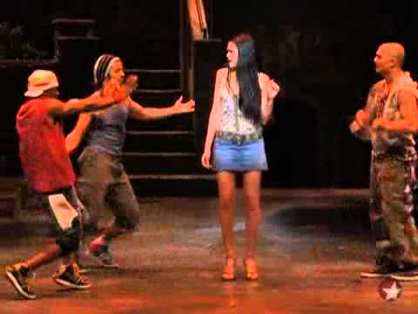
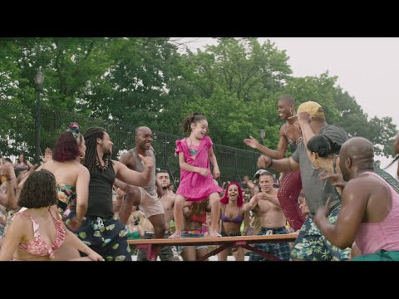
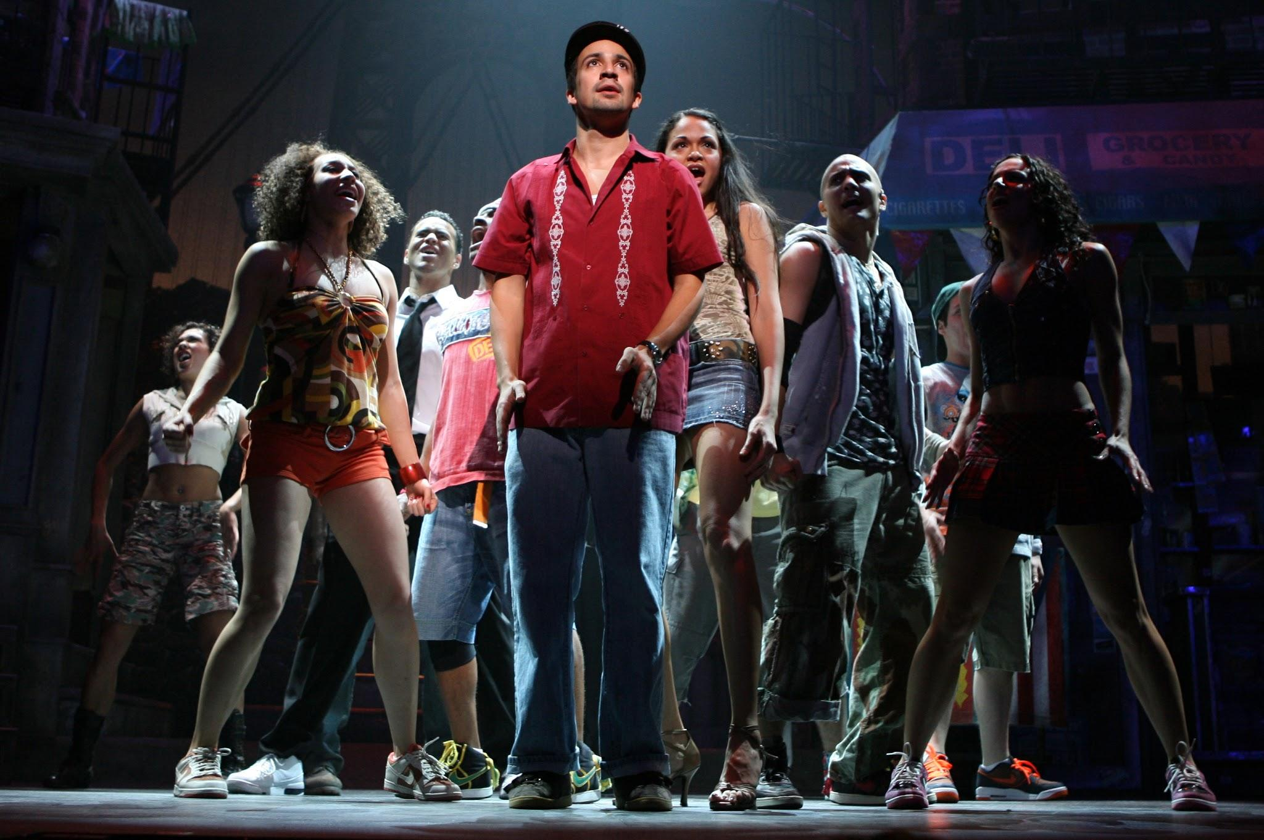
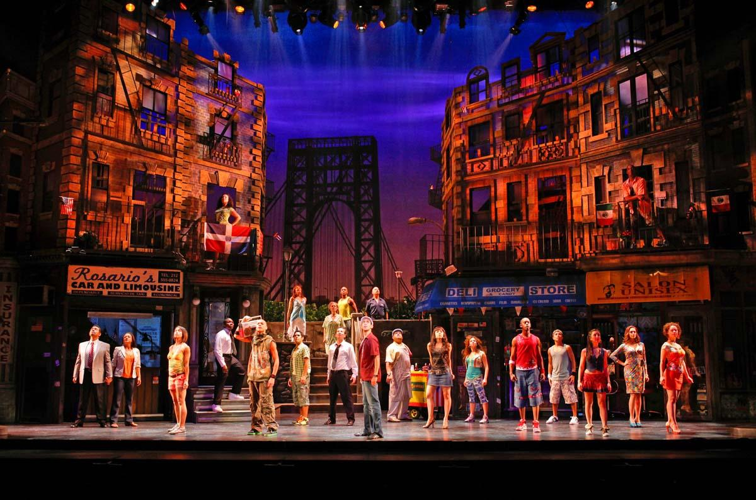
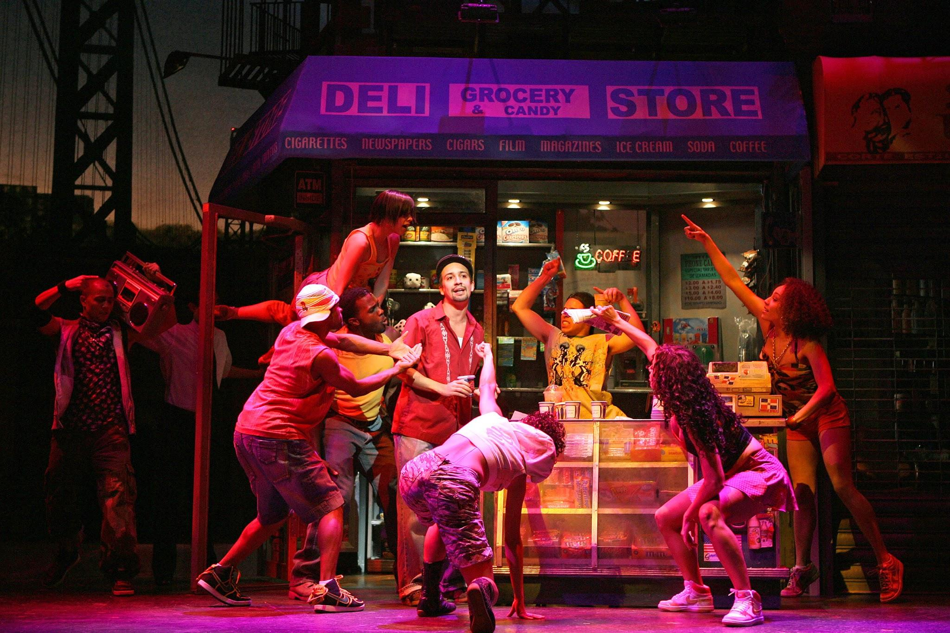
In The Heights
What do you think?
Lin Manuel Miranda is a scholar of Musical
Theatre history. He loves the classics, celebrates new works, and continues to break ground in his own productions. Thinking about the scope of your knowledge of musical theatre so far, what productions so far have inspired you? are you curious about? What communities do you think are missing?
Today’s Date: February 3, 2020
Notes:
I will start with this because I teach a unit on In The Heights at the beginning of second semester.

Slide 5
Hairspray
Here is where a brief summary of the plot of the musical goes. Just enough to give away the story without spoiling the whole thing. No more than three sentences.
Book by: John Smith
Lyrics by: John Smith
Music by: John Smith
Choreography by: John Smith
Opened on Broadway: Sept 9, 2020
Awards, etc.: None
Today’s Date: March 16, 2020
Notes:
I will start with this because I teach a unit on In The Heights at the beginning of second semester.

Slide 6
Matilda
Here is where a brief summary of the plot of the musical goes. Just enough to give away the story without spoiling the whole thing. No more than three sentences.
Book by: John Smith
Lyrics by: John Smith
Music by: John Smith
Choreography by: John Smith
Opened on Broadway: Sept 9, 2020
Awards, etc.: None
Today’s Date: March 23, 2020
Notes:
I will start with this because I teach a unit on In The Heights at the beginning of second semester.

Slide 7
Fun Home
Here is where a brief summary of the plot of the musical goes. Just enough to give away the story without spoiling the whole thing. No more than three sentences.
Book by: John Smith
Lyrics by: John Smith
Music by: John Smith
Choreography by: John Smith
Opened on Broadway: Sept 9, 2020
Awards, etc.: None
Today’s Date: March 30, 2020
Notes:
I will start with this because I teach a unit on In The Heights at the beginning of second semester.

Slide 8
Les Misérables
Here is where a brief summary of the plot of the musical goes. Just enough to give away the story without spoiling the whole thing. No more than three sentences.
Book by: John Smith
Lyrics by: John Smith
Music by: John Smith
Choreography by: John Smith
Opened on Broadway: Sept 9, 2020
Awards, etc.: None
Today’s Date: April 13, 2020
Notes:
I will start with this because I teach a unit on In The Heights at the beginning of second semester.

Slide 9
Guys and Dolls
Here is where a brief summary of the plot of the musical goes. Just enough to give away the story without spoiling the whole thing. No more than three sentences.
Book by: John Smith
Lyrics by: John Smith
Music by: John Smith
Choreography by: John Smith
Opened on Broadway: Sept 9, 2020
Awards, etc.: None
Today’s Date: April 20, 2020
Notes:
I will start with this because I teach a unit on In The Heights at the beginning of second semester.

Slide 10
The Lion King
Here is where a brief summary of the plot of the musical goes. Just enough to give away the story without spoiling the whole thing. No more than three sentences.
Book by: John Smith
Lyrics by: John Smith
Music by: John Smith
Choreography by: John Smith
Opened on Broadway: Sept 9, 2020
Awards, etc.: None
Today’s Date: April 27, 2020
Notes:
I will start with this because I teach a unit on In The Heights at the beginning of second semester.

Slide 11
Kinky Boots
Here is where a brief summary of the plot of the musical goes. Just enough to give away the story without spoiling the whole thing. No more than three sentences.
Book by: John Smith
Lyrics by: John Smith
Music by: John Smith
Choreography by: John Smith
Opened on Broadway: Sept 9, 2020
Awards, etc.: None
Today’s Date: May 4, 2020
Notes:
I will start with this because I teach a unit on In The Heights at the beginning of second semester.

Slide 12
The Book of Mormon
Here is where a brief summary of the plot of the musical goes. Just enough to give away the story without spoiling the whole thing. No more than three sentences.
Book by: John Smith
Lyrics by: John Smith
Music by: John Smith
Choreography by: John Smith
Opened on Broadway: Sept 9, 2020
Awards, etc.: None
Today’s Date: May 11, 2020
Notes:
I will start with this because I teach a unit on In The Heights at the beginning of second semester.

Slide 13
Wicked
Here is where a brief summary of the plot of the musical goes. Just enough to give away the story without spoiling the whole thing. No more than three sentences.
Book by: John Smith
Lyrics by: John Smith
Music by: John Smith
Choreography by: John Smith
Opened on Broadway: Sept 9, 2020
Awards, etc.: None
Today’s Date: May 18, 2020
Notes:
I will start with this because I teach a unit on In The Heights at the beginning of second semester.

Slide 14
The Band’s Visit
Here is where a brief summary of the plot of the musical goes. Just enough to give away the story without spoiling the whole thing. No more than three sentences.
Book by: John Smith
Lyrics by: John Smith
Music by: John Smith
Choreography by: John Smith
Opened on Broadway: Sept 9, 2020
Awards, etc.: None
Today’s Date: June 1, 2020
Notes:
I will start with this because I teach a unit on In The Heights at the beginning of second semester.

Slide 15
Hadestown
Here is where a brief summary of the plot of the musical goes. Just enough to give away the story without spoiling the whole thing. No more than three sentences.
Book by: John Smith
Lyrics by: John Smith
Music by: John Smith
Choreography by: John Smith
Opened on Broadway: Sept 9, 2020
Awards, etc.: None
Today’s Date: June 8, 2020
Notes:
I will start with this because I teach a unit on In The Heights at the beginning of second semester.

Slide 16
Current Tony Award Nominees
These are the nominees for (and winner of) the Tony Award for Best Musical this year.
TITLE
Short summary.
TITLE
Short summary.
TITLE
Short summary.
TITLE
Short summary.
TITLE
Short summary.
Today’s Date: June 15, 2020
Notes:
I will start with this because I teach a unit on In The Heights at the beginning of second semester.

Slide 17
Works Cited
Copyright Disclaimer
I do not own copyright on any of the images or videos embedded into this file.
This Slides document is NOT intended for resale. I created this in the spirit of sharing and that is how it is intended to be used.
Information for the summaries, production information, and questions were drawn from various internet sources and searches including: playbill.com, broadwayworld.com, musicals101.com, broadwaymusicalhome.com, broadway.org, americantheatrewing.org, and en.wikipedia.org. I also referenced several articles from Daily Beast, New York Times, and The New Yorker. Most videos are from YouTube.com
I hope you and your students enjoy using this resource!

